Slide 1

SQLite Lab
Reza Dibaj

Slide 2
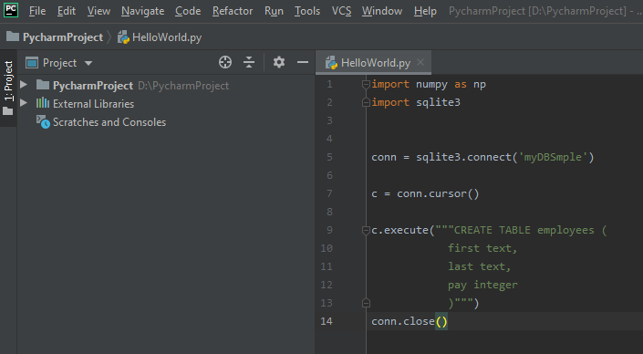
A Sample Code
The following code should work without any SQLite installation… Guess why? ☺
Notes:
import numpy as np import sqlite3 conn = sqlite3.connect('myDBSmple') c = conn.cursor() c.execute("""CREATE TABLE employees ( first text, last text, pay integer )""") conn.close()

Slide 3
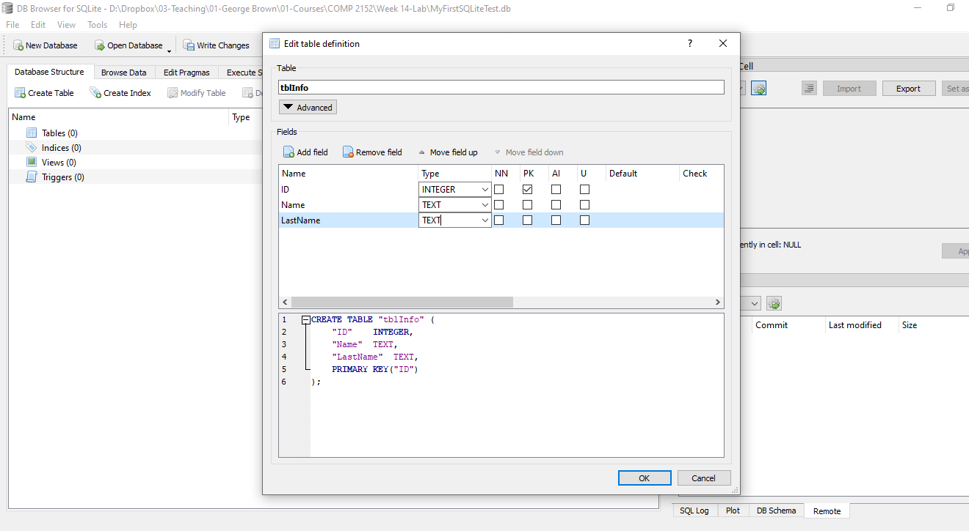
Creating a DB and a Sample Table
This is simply how we create a DB & a Table….

Slide 4
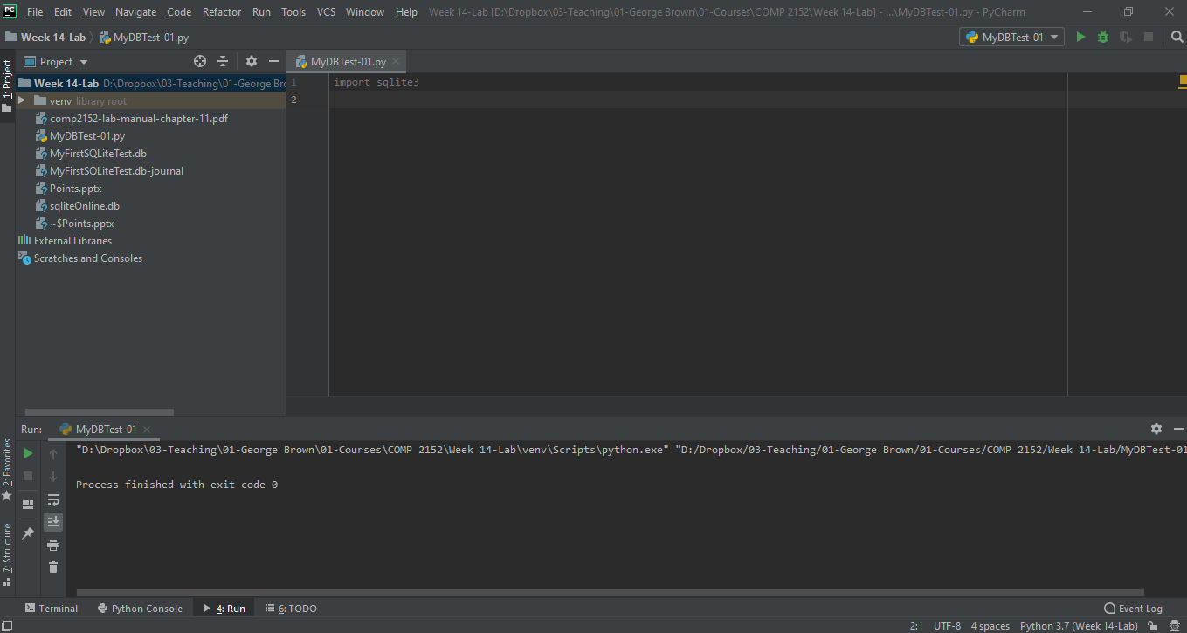
Creating a Python file and starting our journey
It works!!!
Notes:
import sqlite3

Slide 5
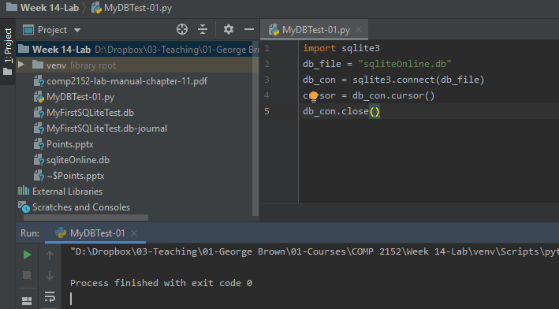
Creating a Python file and starting our journey
It works!!!
Notes:
import sqlite3 db_file = "sqliteOnline.db" db_con = sqlite3.connect(db_file) cursor = db_con.cursor() db_con.close()

Slide 6
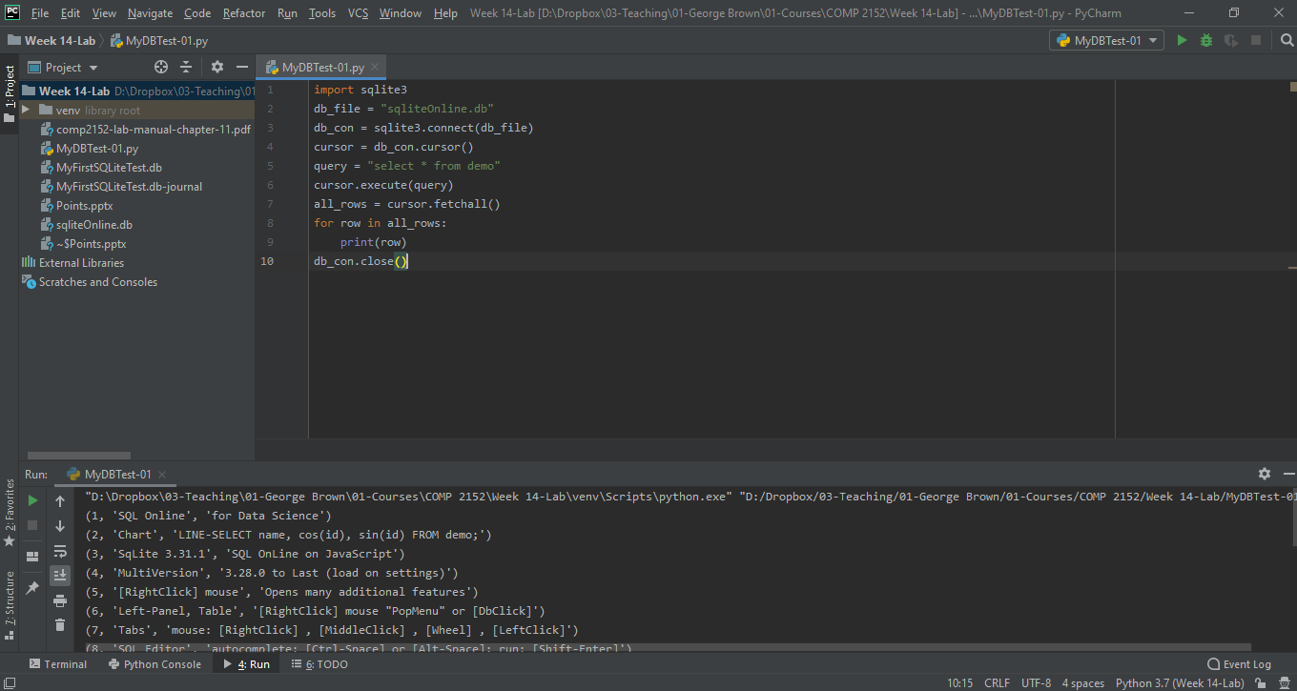
Creating a Python file and starting our journey
Let’s try this!
Notes:
import sqlite3 db_file = "sqliteOnline.db" db_con = sqlite3.connect(db_file) cursor = db_con.cursor() query = "select * from demo" cursor.execute(query) all_rows = cursor.fetchall() for row in all_rows: print(row) db_con.close()

Slide 7
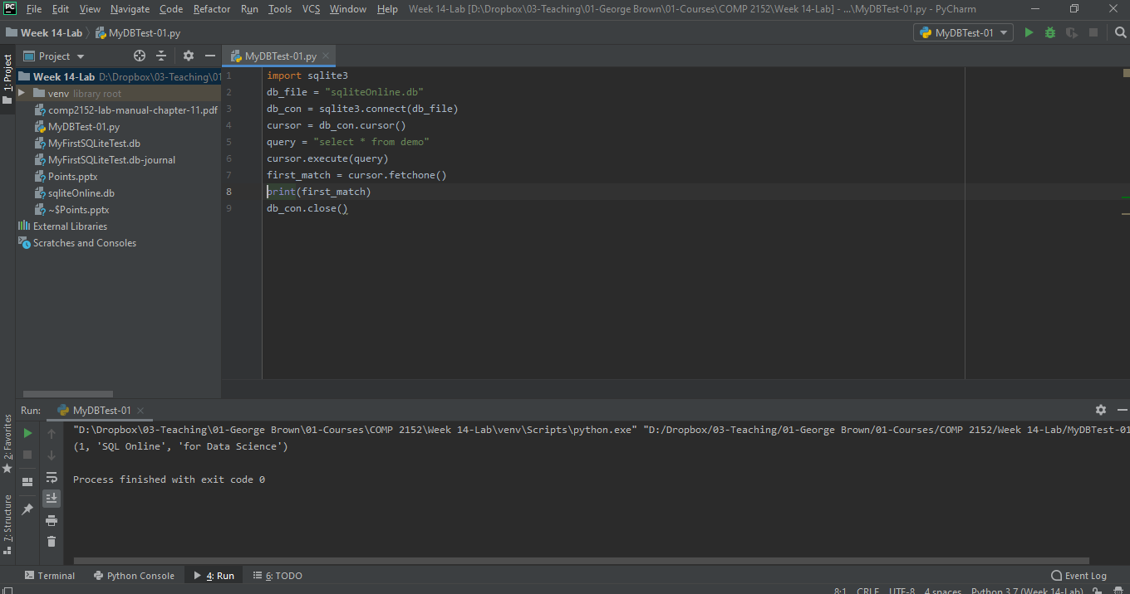
Creating a Python file and starting our journey
And this!
Notes:
import sqlite3 db_file = "sqliteOnline.db" db_con = sqlite3.connect(db_file) cursor = db_con.cursor() query = "select * from demo" cursor.execute(query) first_match = cursor.fetchone() print(first_match) db_con.close()

Slide 8
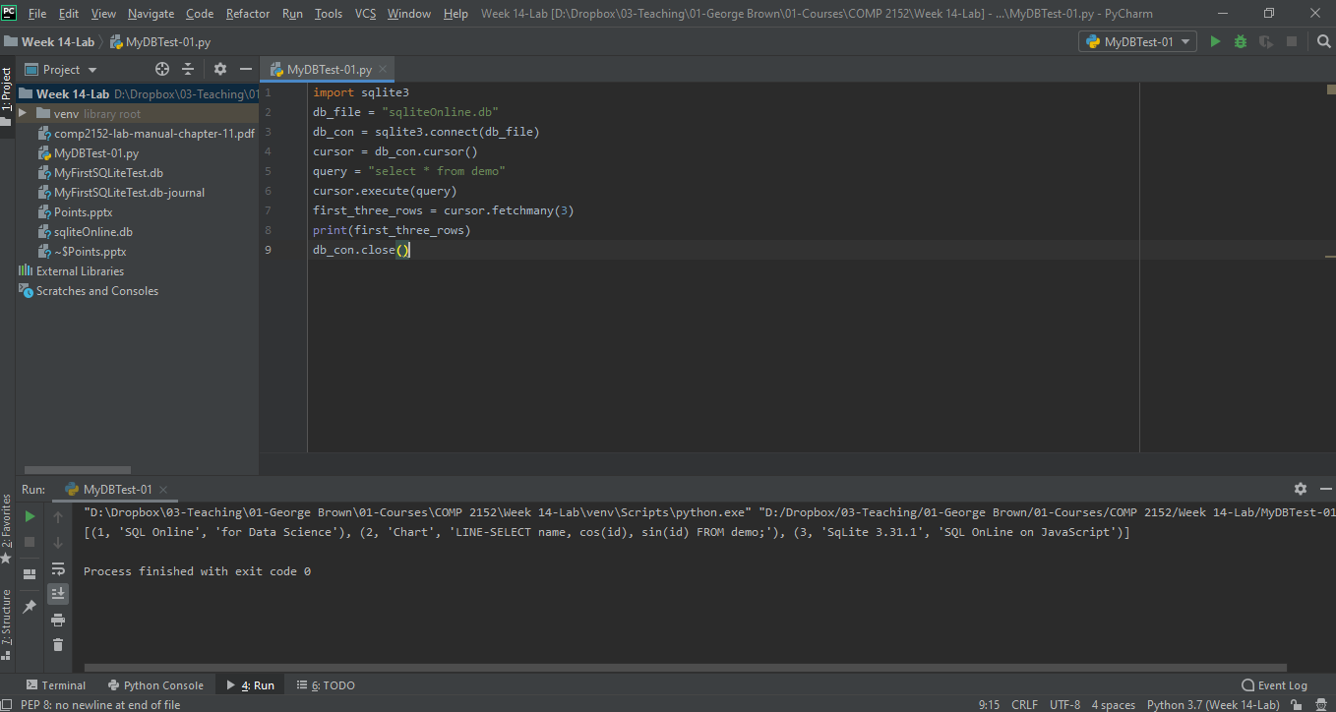
Creating a Python file and starting our journey
Fetching the first 3 rows…
Notes:
import sqlite3 db_file = "sqliteOnline.db" db_con = sqlite3.connect(db_file) cursor = db_con.cursor() query = "select * from demo" cursor.execute(query) first_three_rows = cursor.fetchmany(3) print(first_three_rows) db_con.close()

Slide 9
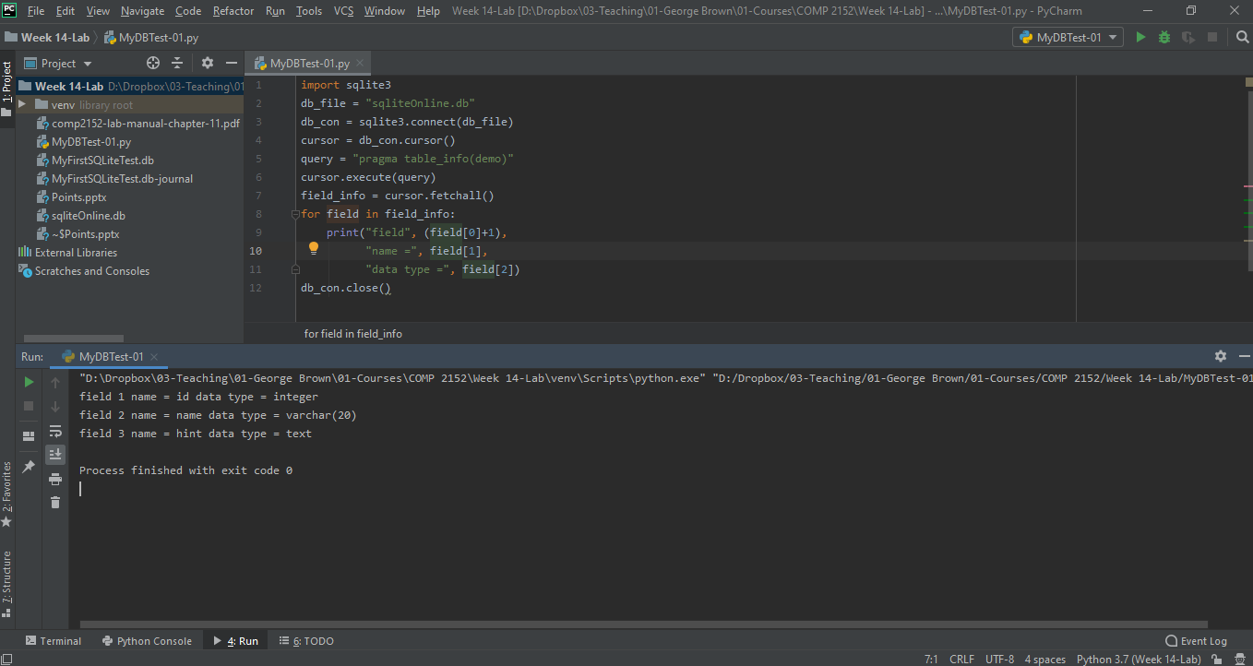
Creating a Python file and starting our journey
Table’s Metadata….
Notes:
import sqlite3 db_file = "sqliteOnline.db" db_con = sqlite3.connect(db_file) cursor = db_con.cursor() query = "pragma table_info(demo)" cursor.execute(query) field_info = cursor.fetchall() for field in field_info: print("field", (field[0]+1), "name =", field[1], "data type =", field[2]) db_con.close()

Slide 10
Creating a Python file and starting our journey
Table’s Metadata….
Notes:
import sqlite3 db_file = "sqliteOnline.db" db_con = sqlite3.connect(db_file) cursor = db_con.cursor() query = "pragma table_info(demo)" cursor.execute(query) field_info = cursor.fetchall() for field in field_info: print("field", (field[0]+1), "name =", field[1], "data type =", field[2]) db_con.close()

Slide 11
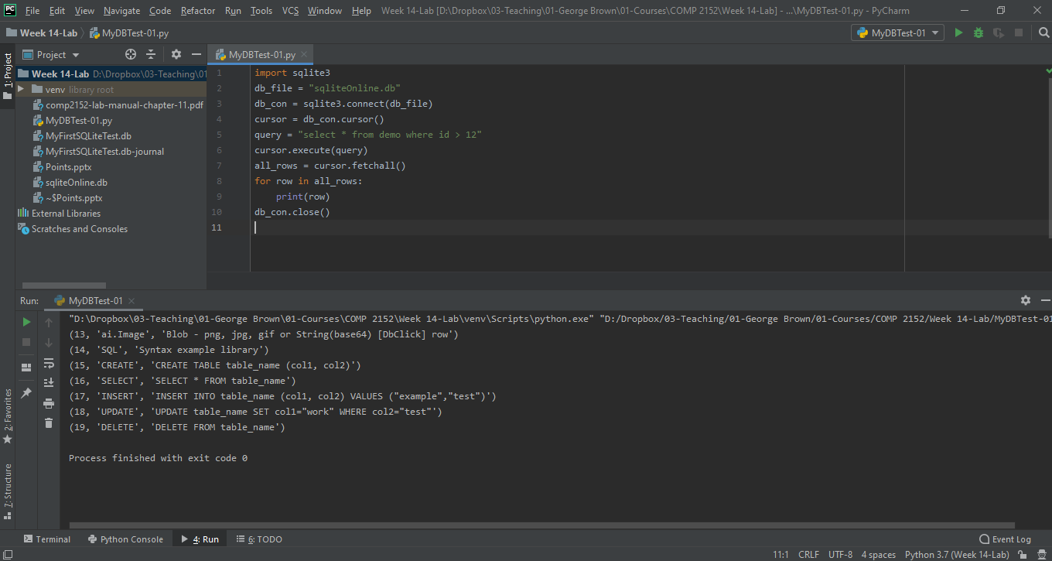
Creating a Python file and starting our journey
Selecting with Parameters
Notes:
import sqlite3 db_file = "sqliteOnline.db" db_con = sqlite3.connect(db_file) cursor = db_con.cursor() query = "select * from demo where id > 12" cursor.execute(query) all_rows = cursor.fetchall() for row in all_rows: print(row) db_con.close()

Slide 12
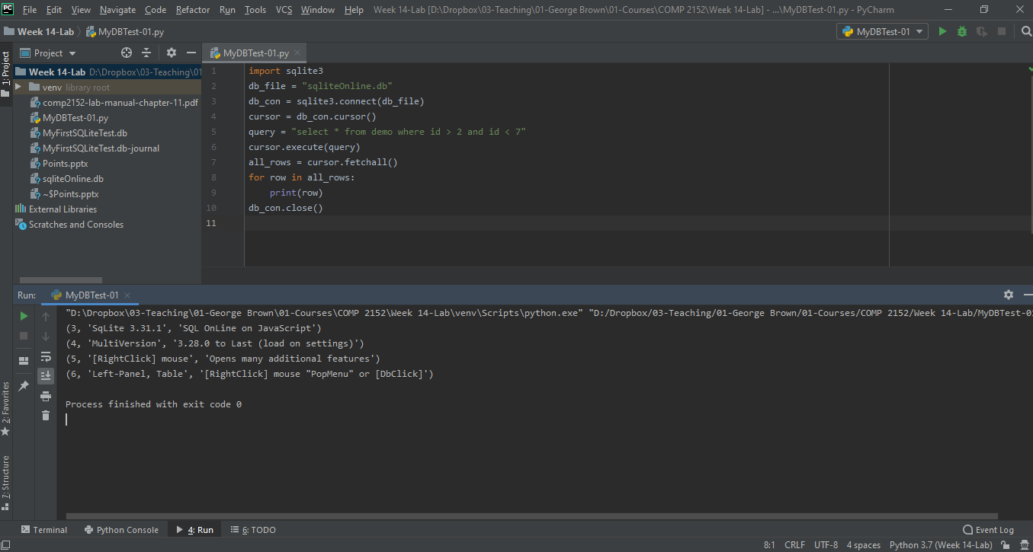
Creating a Python file and starting our journey
Selecting with Parameters…. Another example
Notes:
import sqlite3 db_file = "sqliteOnline.db" db_con = sqlite3.connect(db_file) cursor = db_con.cursor() query = "select * from demo where id > 2 and id < 7" cursor.execute(query) all_rows = cursor.fetchall() for row in all_rows: print(row) db_con.close()

Slide 13
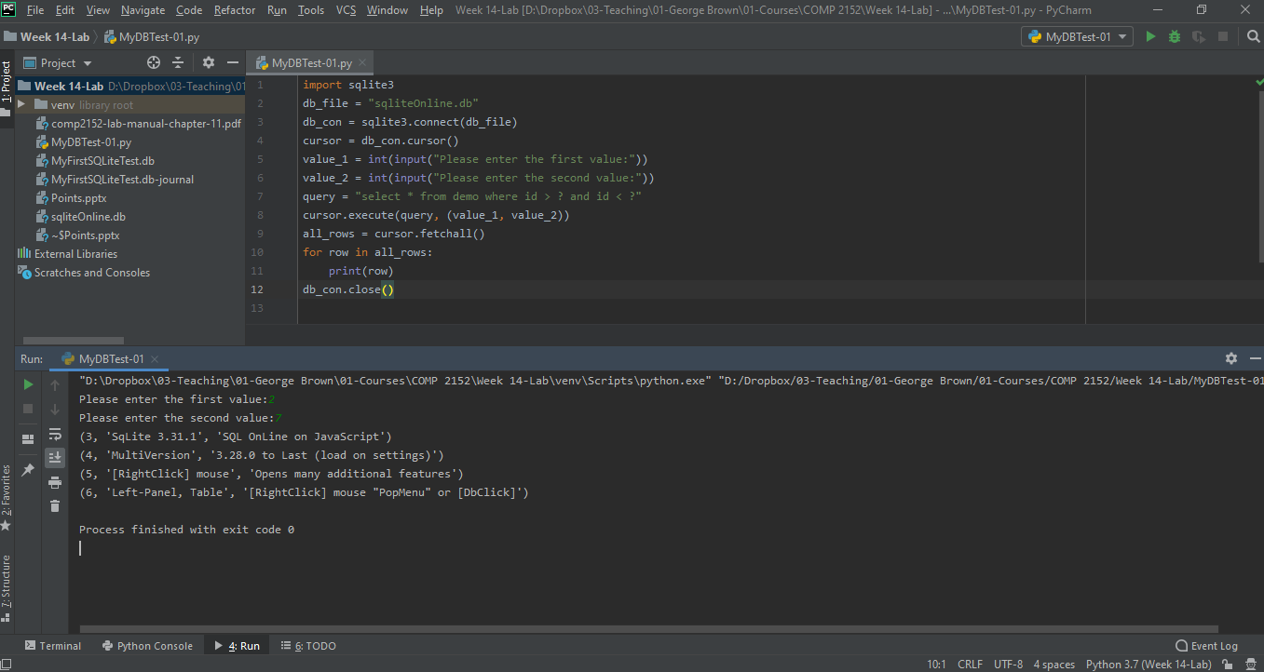
Creating a Python file and starting our journey
Selecting with Parameters…. Another example
Notes:
import sqlite3 db_file = "sqliteOnline.db" db_con = sqlite3.connect(db_file) cursor = db_con.cursor() value_1 = int(input("Please enter the first value:")) value_2 = int(input("Please enter the second value:")) query = "select * from demo where id > ? and id < ?" cursor.execute(query, (value_1, value_2)) all_rows = cursor.fetchall() for row in all_rows: print(row) db_con.close()

Slide 14
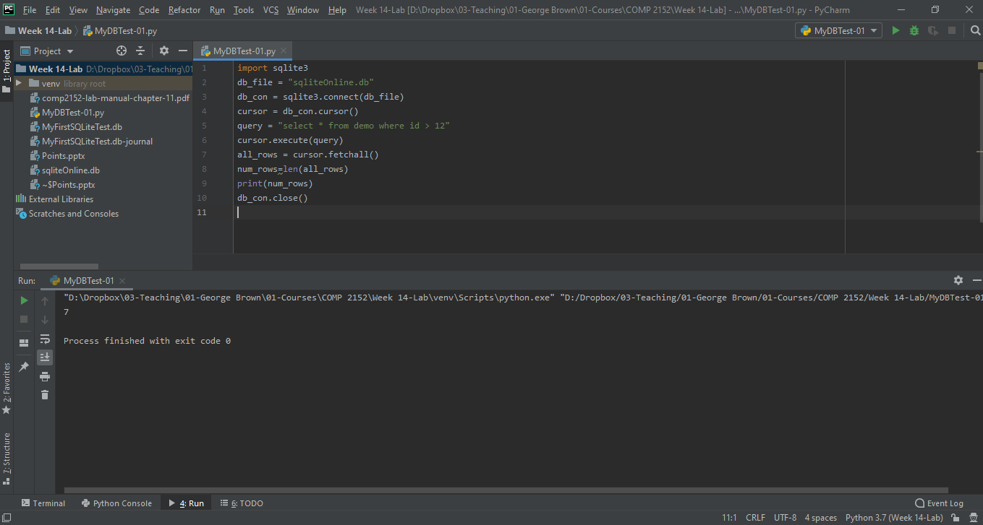
Creating a Python file and starting our journey
Selecting with Parameters…. Another example
Notes:
import sqlite3 db_file = "sqliteOnline.db" db_con = sqlite3.connect(db_file) cursor = db_con.cursor() query = "select * from demo where id > 12" cursor.execute(query) all_rows = cursor.fetchall() num_rows=len(all_rows) print(num_rows) db_con.close()

Slide 15
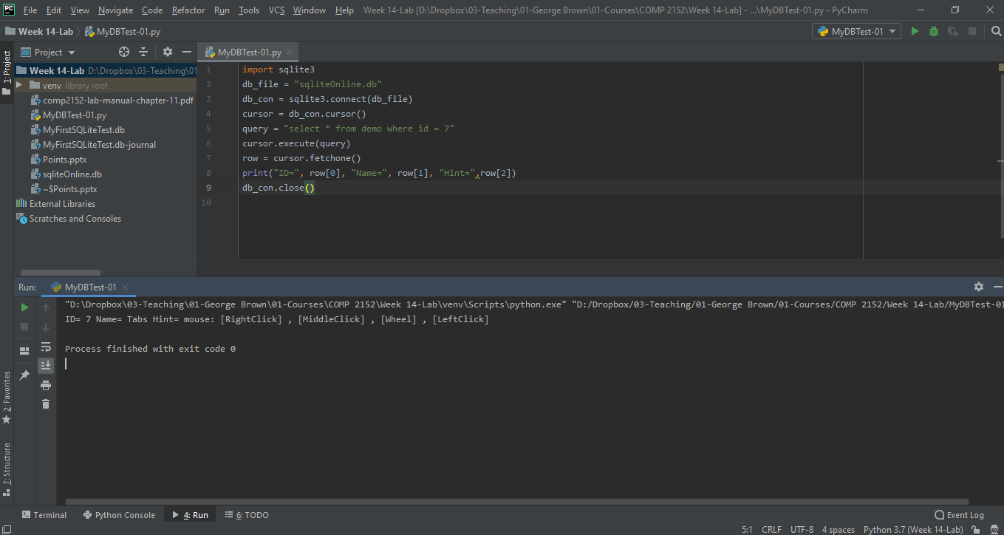
Creating a Python file and starting our journey
INDEX BASED INDICES
Notes:
import sqlite3 db_file = "sqliteOnline.db" db_con = sqlite3.connect(db_file) cursor = db_con.cursor() query = "select * from demo where id = 7" cursor.execute(query) row = cursor.fetchone() print("ID=", row[0], "Name=", row[1], "Hint=",row[2]) db_con.close()

Slide 16
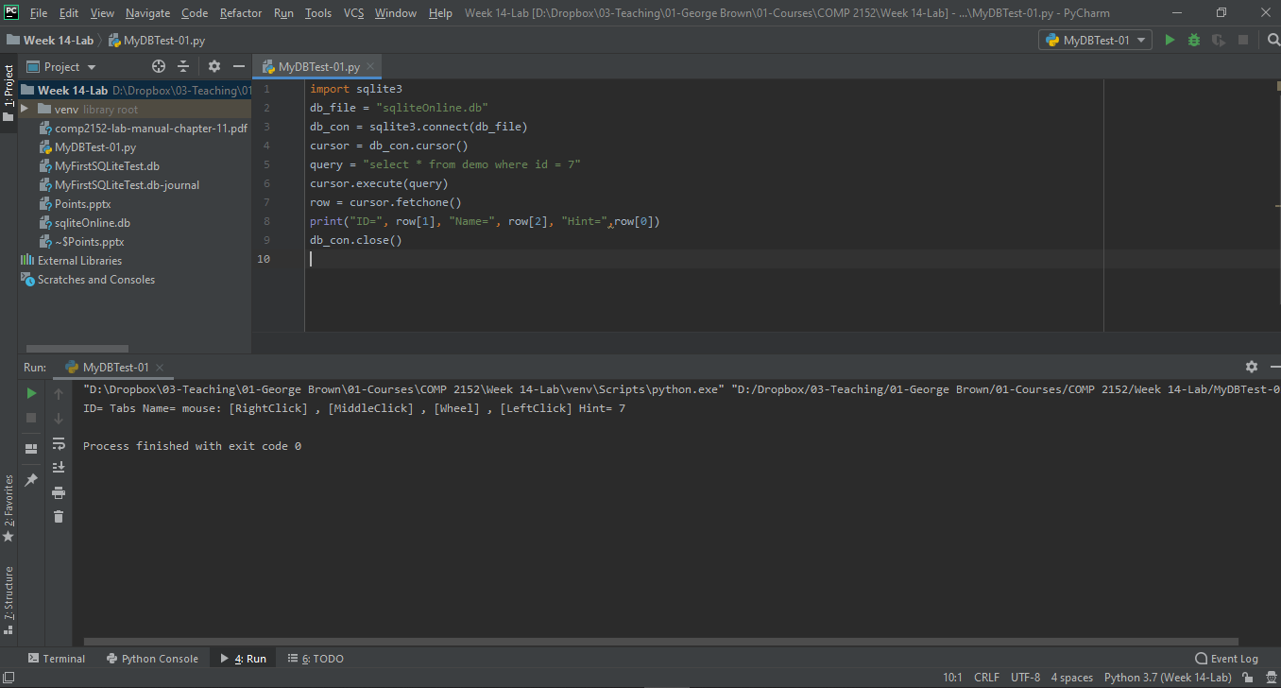
Creating a Python file and starting our journey
INDEX BASED INDICES… MISTAKE!!!
Notes:
import sqlite3 db_file = "sqliteOnline.db" db_con = sqlite3.connect(db_file) cursor = db_con.cursor() query = "select * from demo where id = 7" cursor.execute(query) row = cursor.fetchone() print("ID=", row[1], "Name=", row[2], "Hint=",row[0]) db_con.close()

Slide 17
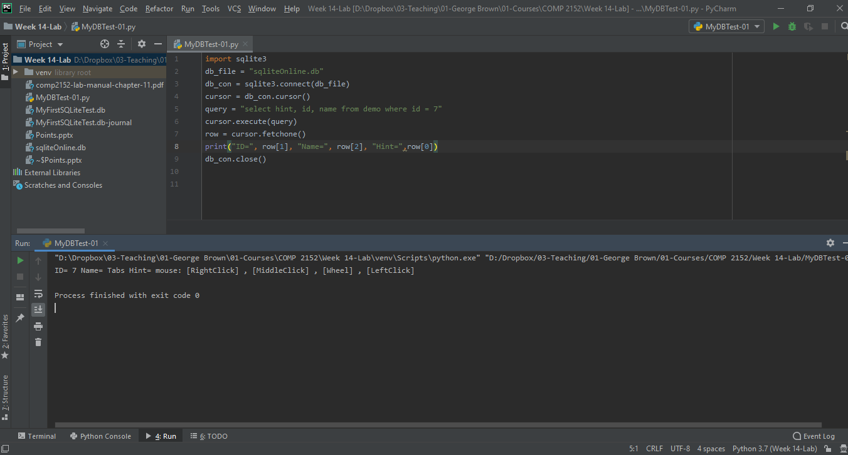
Creating a Python file and starting our journey
INDEX BASED INDICES… Fixed!!!
Notes:
import sqlite3 db_file = "sqliteOnline.db" db_con = sqlite3.connect(db_file) cursor = db_con.cursor() query = "select hint, id, name from demo where id = 7" cursor.execute(query) row = cursor.fetchone() print("ID=", row[1], "Name=", row[2], "Hint=",row[0]) db_con.close()

Slide 18

Creating a Python file and starting our journey
Multiple Rows…. 1
Notes:
import sqlite3 db_file = "sqliteOnline.db" db_con = sqlite3.connect(db_file) cursor = db_con.cursor() query = "select * from demo where id in (7,8)" cursor.execute(query) row = cursor.fetchall() print("ID=", row[0][0], "Name=", row[0][1], "Hint=", row[0][2]) print("ID=", row[1][0], "Name=", row[1][1], "Hint=", row[1][2]) db_con.close()

Slide 19

Creating a Python file and starting our journey
Multiple Rows…. 2
Notes:
import sqlite3 db_file = "sqliteOnline.db" db_con = sqlite3.connect(db_file) cursor = db_con.cursor() query = "select hint, id, name from demo where id in (7,8)" cursor.execute(query) row = cursor.fetchall() print("ID=", row[0][1], "Name=", row[0][2], "Hint=", row[0][0]) print("ID=", row[1][1], "Name=", row[1][2], "Hint=", row[1][0]) db_con.close()

Slide 20
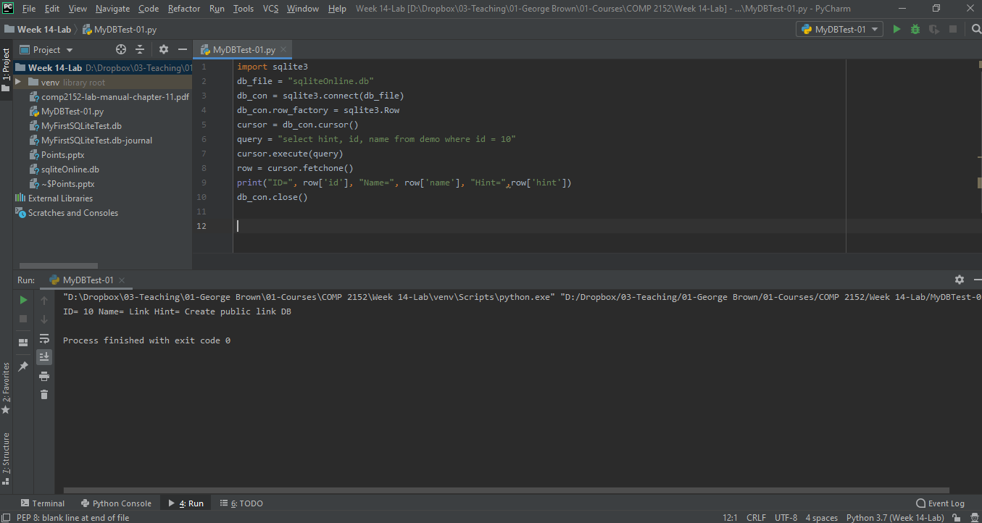
Creating a Python file and starting our journey
NAME BASED INDICES
Notes:
import sqlite3 db_file = "sqliteOnline.db" db_con = sqlite3.connect(db_file) db_con.row_factory = sqlite3.Row cursor = db_con.cursor() query = "select hint, id, name from demo where id = 10" cursor.execute(query) row = cursor.fetchone() print("ID=", row['id'], "Name=", row['name'], "Hint=",row['hint']) db_con.close()

Slide 21
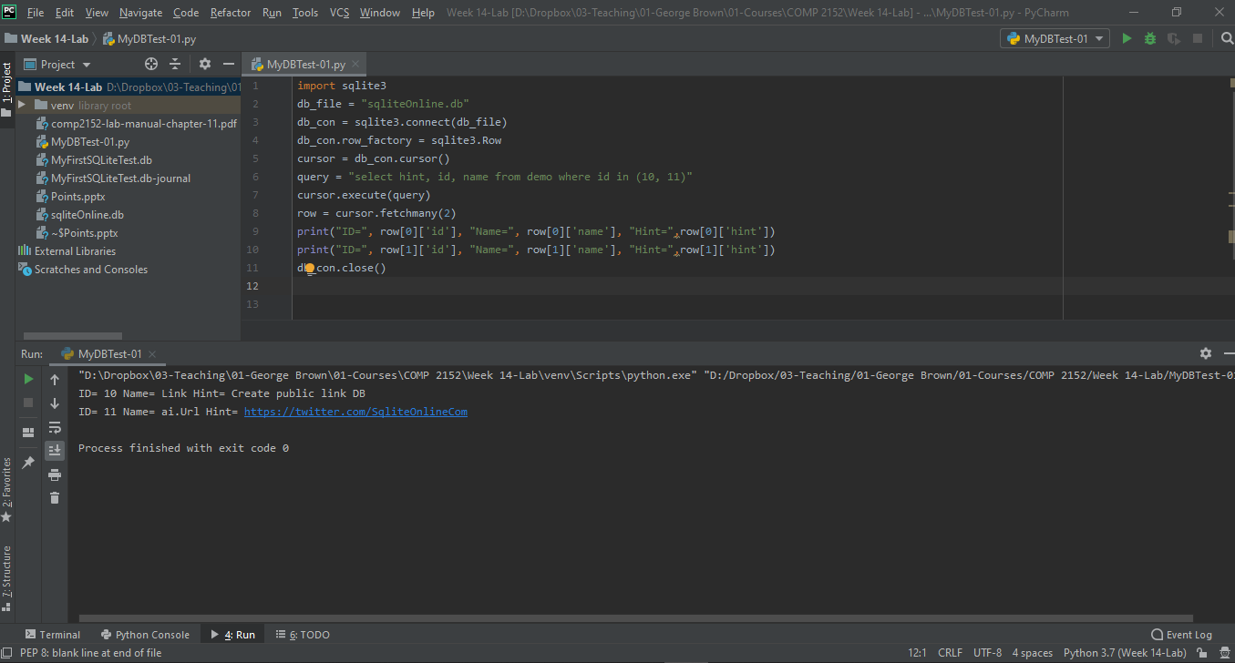
Creating a Python file and starting our journey
NAME BASED INDICES
Notes:
import sqlite3 db_file = "sqliteOnline.db" db_con = sqlite3.connect(db_file) db_con.row_factory = sqlite3.Row cursor = db_con.cursor() query = "select hint, id, name from demo where id in (10, 11)" cursor.execute(query) row = cursor.fetchmany(2) print("ID=", row[0]['id'], "Name=", row[0]['name'], "Hint=",row[0]['hint']) print("ID=", row[1]['id'], "Name=", row[1]['name'], "Hint=",row[1]['hint']) db_con.close()

Slide 22
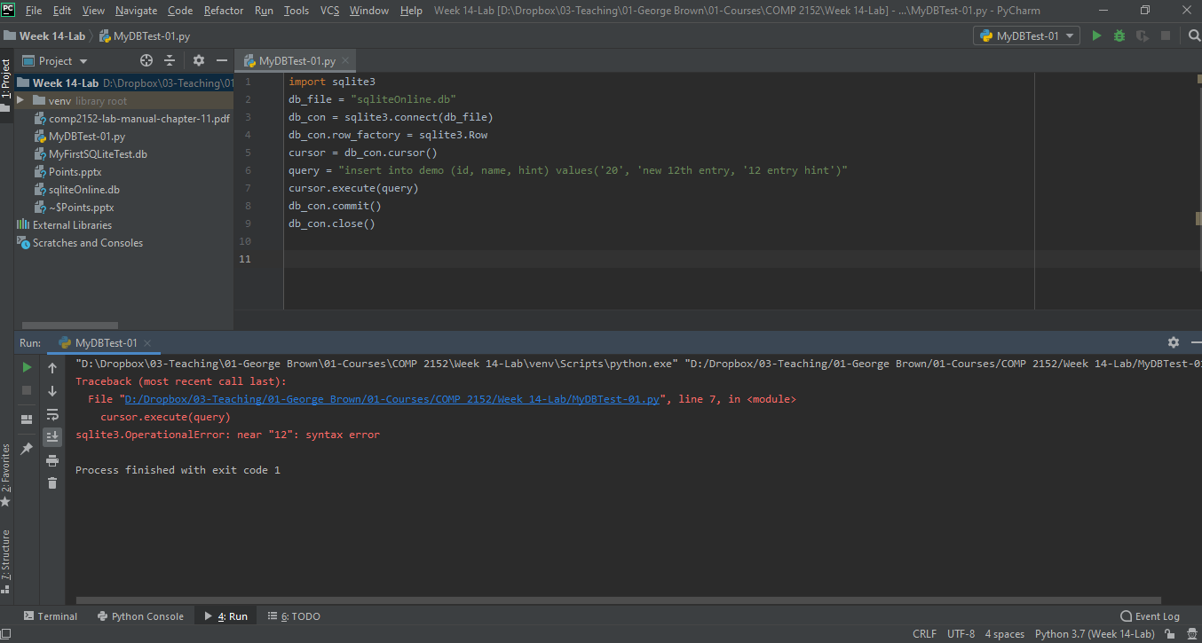
Creating a Python file and starting our journey
Insert… Where is my Error?
Notes:
import sqlite3 db_file = "sqliteOnline.db" db_con = sqlite3.connect(db_file) cursor = db_con.cursor() query = "insert into demo (id, name, hint) values('20', 'new 12th entry, '12 entry hint')" cursor.execute(query) db_con.commit() db_con.close()

Slide 23
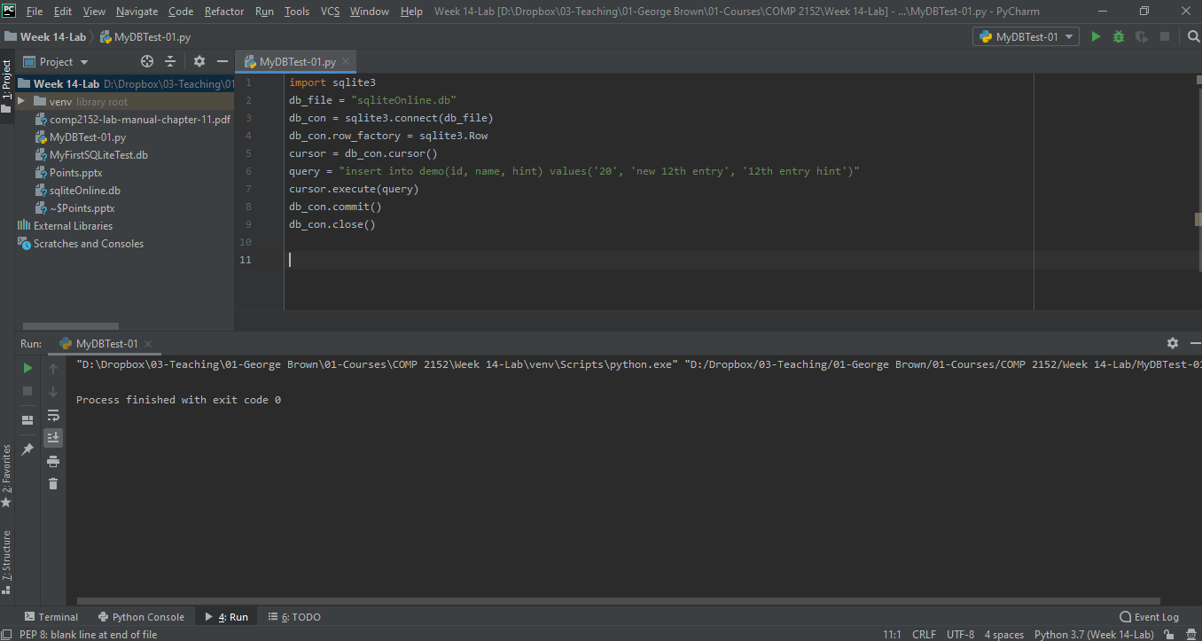
Creating a Python file and starting our journey
Insert
Notes:
import sqlite3 db_file = "sqliteOnline.db" db_con = sqlite3.connect(db_file) cursor = db_con.cursor() query = "insert into demo(id, name, hint) values('20', 'new 12th entry', '12th entry hint')" cursor.execute(query) db_con.commit() db_con.close()

Slide 24
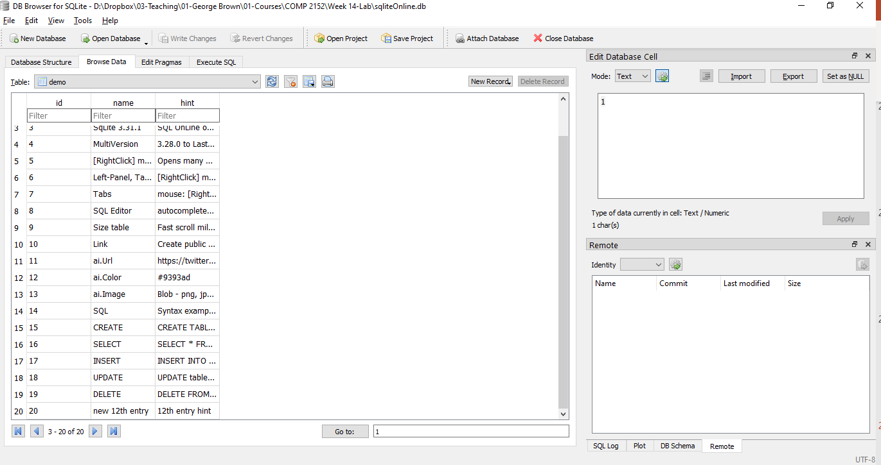
Creating a Python file and starting our journey
The Result

Slide 25
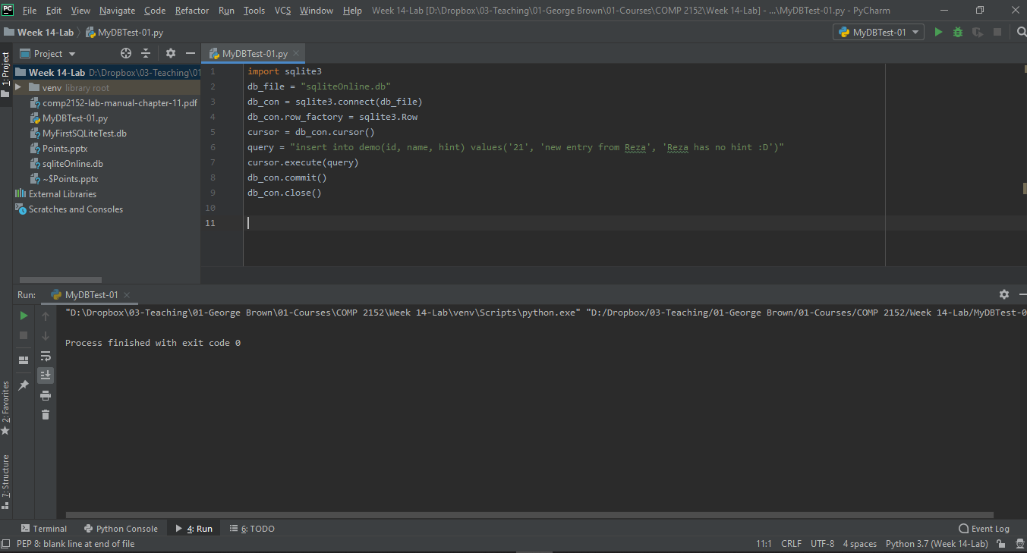
Creating a Python file and starting our journey
Insert …. Another Example
Notes:
import sqlite3 db_file = "sqliteOnline.db" db_con = sqlite3.connect(db_file) db_con.row_factory = sqlite3.Row cursor = db_con.cursor() query = "insert into demo(id, name, hint) values('21', 'new entry from Reza', 'Reza has no hint :D')" cursor.execute(query) db_con.commit() db_con.close()

Slide 26
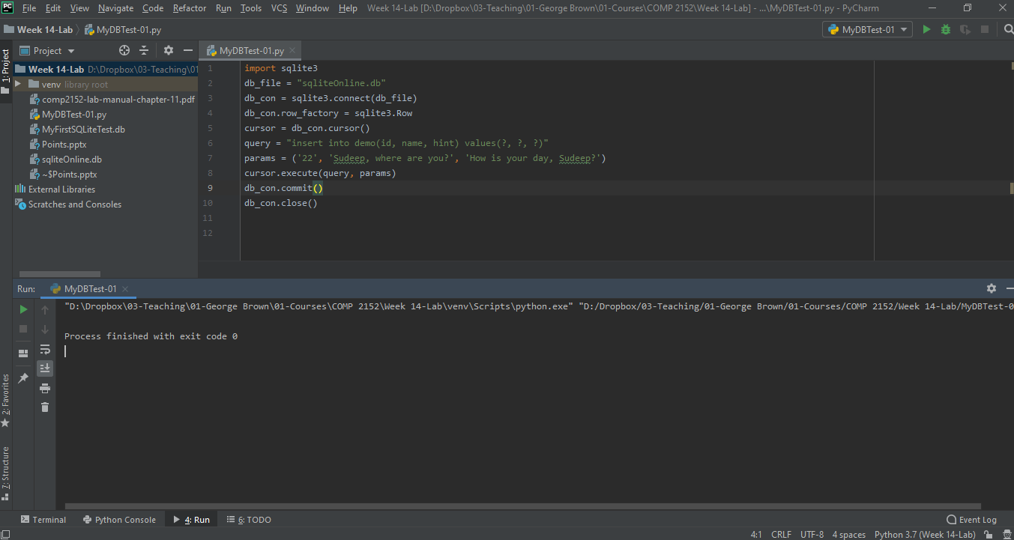
Creating a Python file and starting our journey
Insert …. Sudeep! Listen! :D
Notes:
import sqlite3 db_file = "sqliteOnline.db" db_con = sqlite3.connect(db_file) cursor = db_con.cursor() query = "insert into demo(id, name, hint) values(?, ?, ?)" params = ('22', 'Sudeep, where are you?', 'How is your day, Sudeep?') cursor.execute(query, params) db_con.commit() db_con.close()

Slide 27
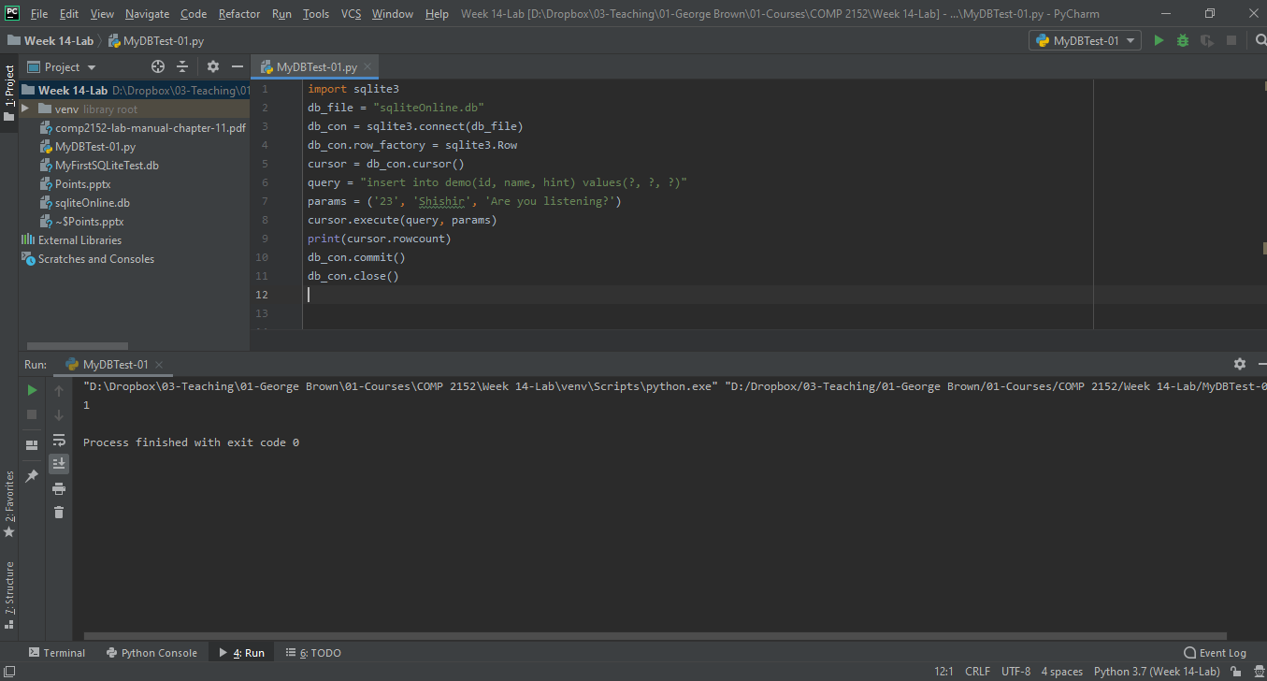
Creating a Python file and starting our journey
Insert …. Shishir! Listen! :D
Notes:
import sqlite3 db_file = "sqliteOnline.db" db_con = sqlite3.connect(db_file) cursor = db_con.cursor() query = "insert into demo(id, name, hint) values(?, ?, ?)" params = ('23', 'Shishir', 'Are you listening?') cursor.execute(query, params) print(cursor.rowcount) db_con.commit() db_con.close()

Slide 28
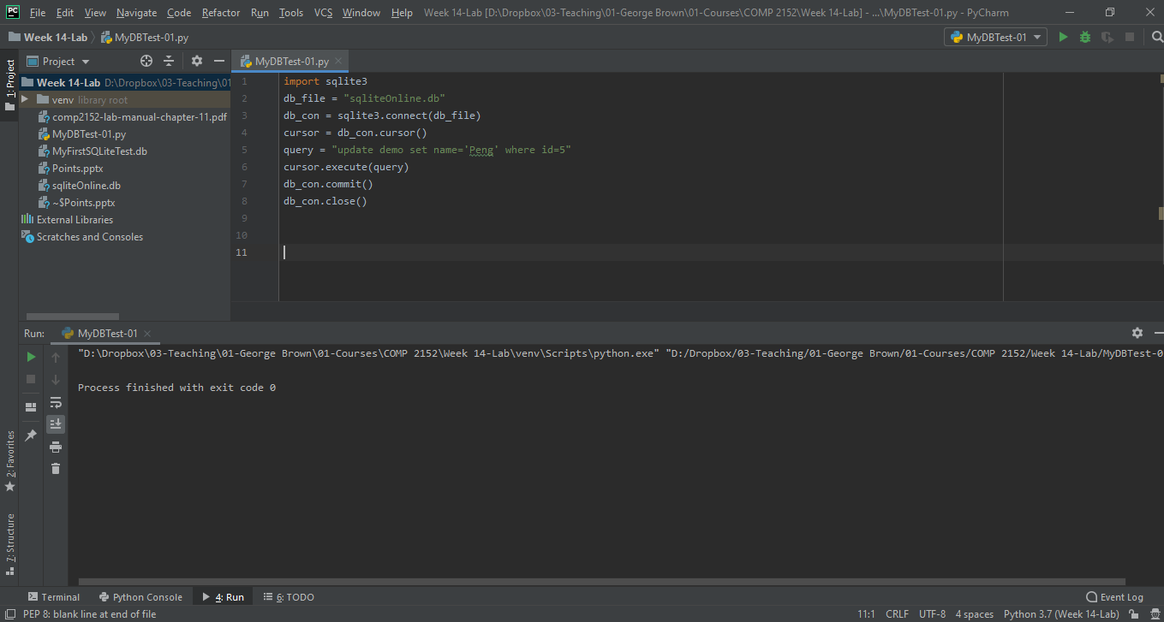
Creating a Python file and starting our journey
Updating….
Notes:
import sqlite3 db_file = "sqliteOnline.db" db_con = sqlite3.connect(db_file) cursor = db_con.cursor() query = "update demo set name='Peng' where id=5" cursor.execute(query) db_con.commit() db_con.close()

Slide 29
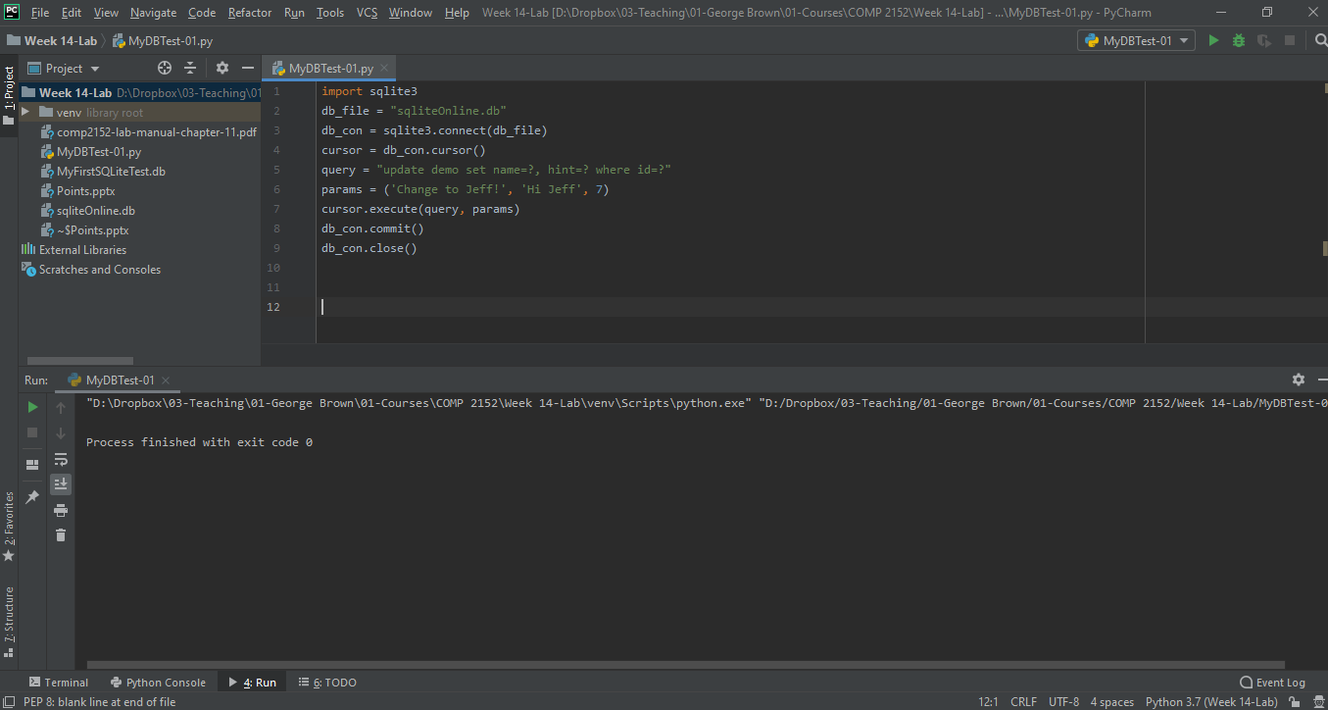
Creating a Python file and starting our journey
Updating…. With params
Notes:
import sqlite3 db_file = "sqliteOnline.db" db_con = sqlite3.connect(db_file) cursor = db_con.cursor() query = "update demo set name=?, hint=? where id=?" params = ('Change to Jeff!', 'Hi Jeff', 7) cursor.execute(query, params) db_con.commit() db_con.close()

Slide 30
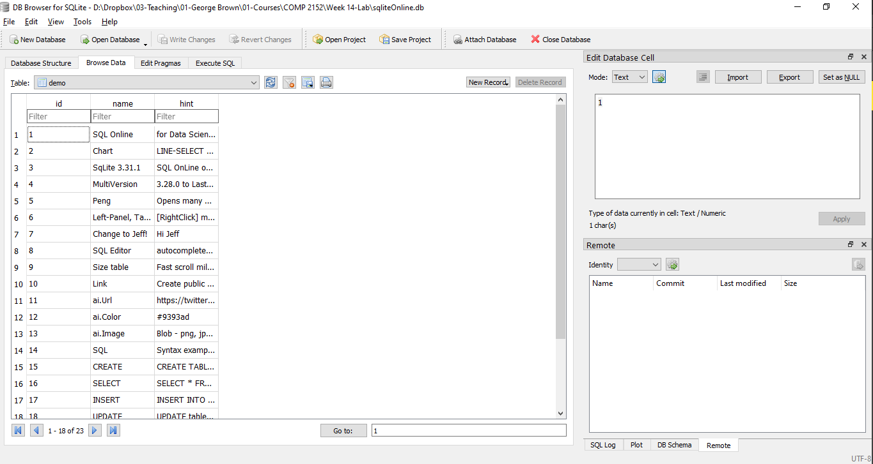
Creating a Python file and starting our journey
The Results….

Slide 31
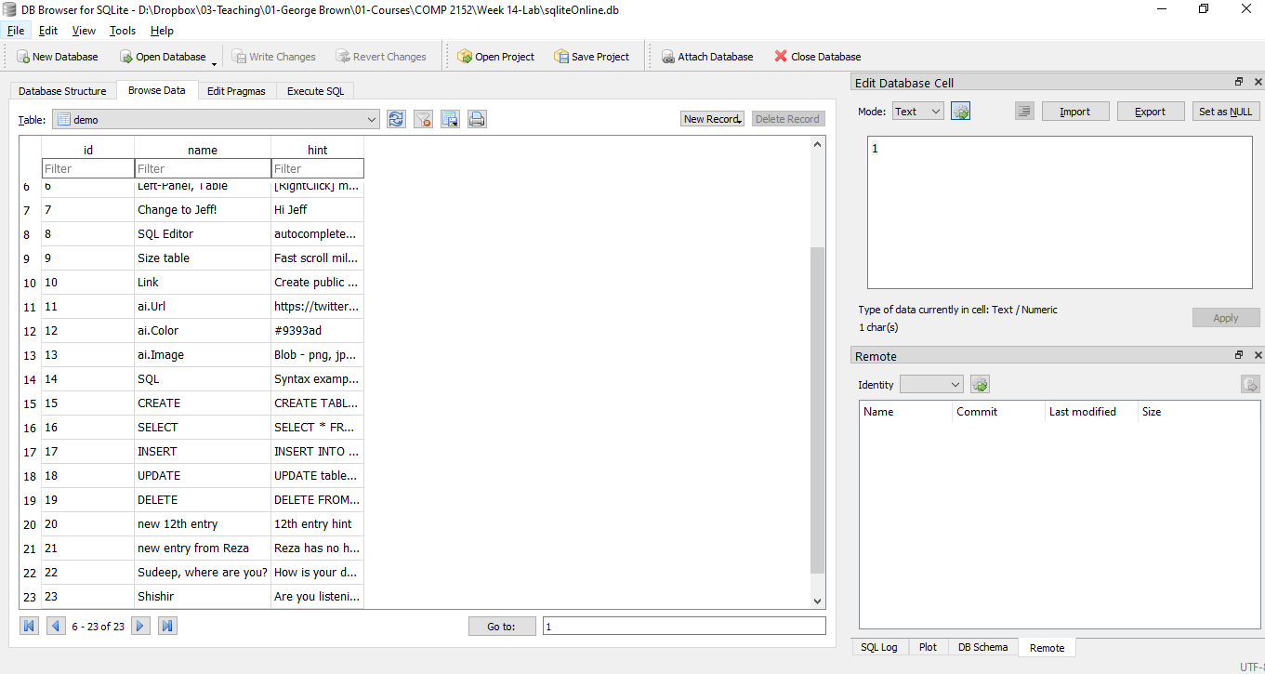
Creating a Python file and starting our journey
The Results….

Slide 32
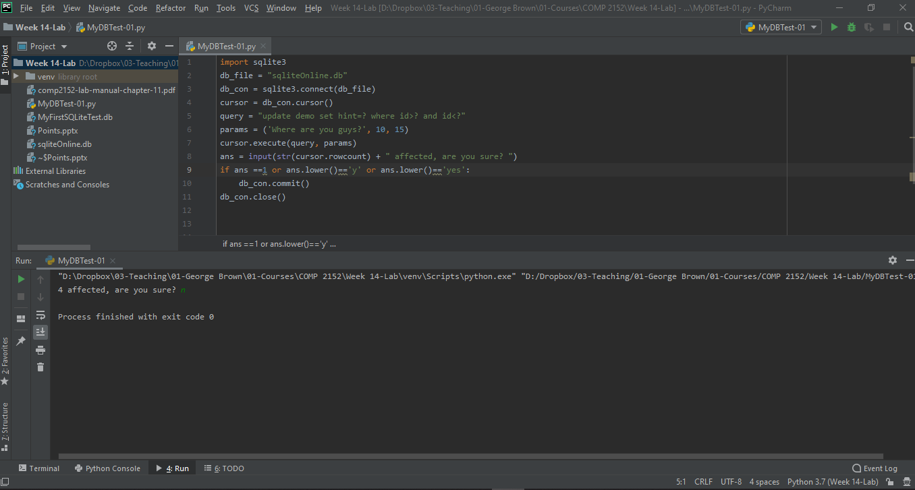
Creating a Python file and starting our journey
Updating…. With params
Notes:
import sqlite3 db_file = "sqliteOnline.db" db_con = sqlite3.connect(db_file) cursor = db_con.cursor() query = "update demo set hint=? where id>? and id<?" params = ('Where are you guys?', 10, 15) cursor.execute(query, params) ans = input(str(cursor.rowcount) + " affected, are you sure? ") if ans ==1 or ans.lower()=='y' or ans.lower()=='yes': db_con.commit() db_con.close()

Slide 33

Creating a Python file and starting our journey
Deleting….
Notes:
import sqlite3 db_file = "sqliteOnline.db" db_con = sqlite3.connect(db_file) cursor = db_con.cursor() query = "delete from demo where id=4" cursor.execute(query) db_con.commit() db_con.close()

Slide 34
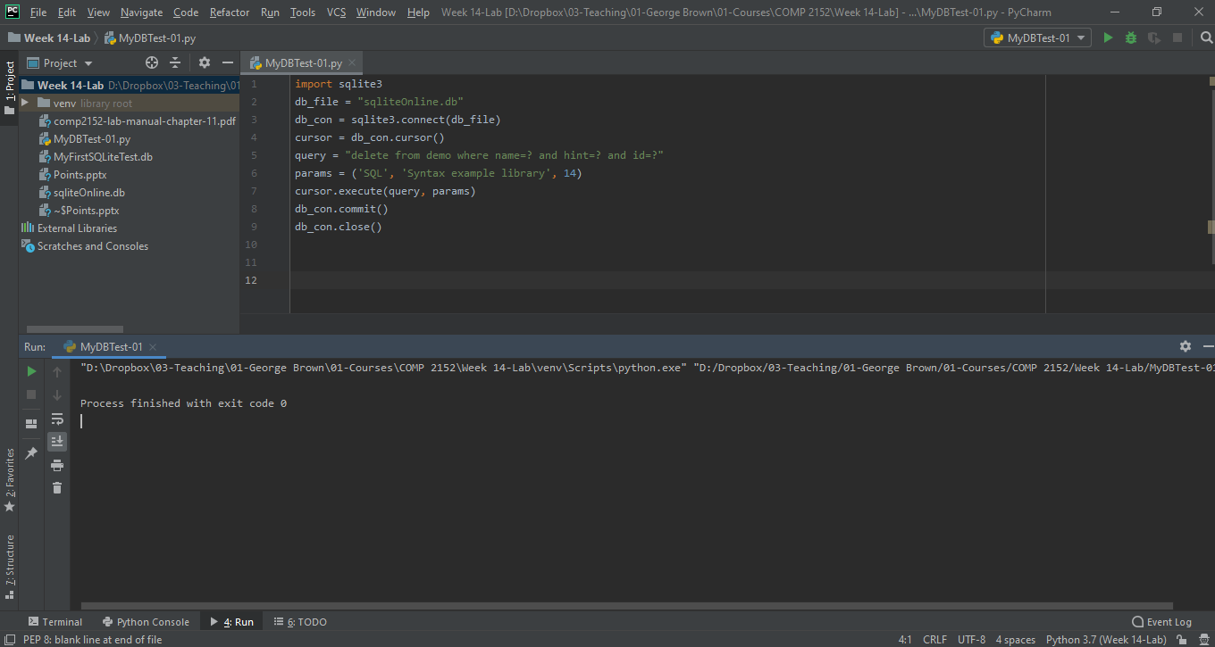
Creating a Python file and starting our journey
Deleting…. With params
Notes:
import sqlite3 db_file = "sqliteOnline.db" db_con = sqlite3.connect(db_file) cursor = db_con.cursor() query = "delete from demo where name=? and hint=? and id=?" params = ('SQL', 'Syntax example library', 14) cursor.execute(query, params) db_con.commit() db_con.close()

Slide 35
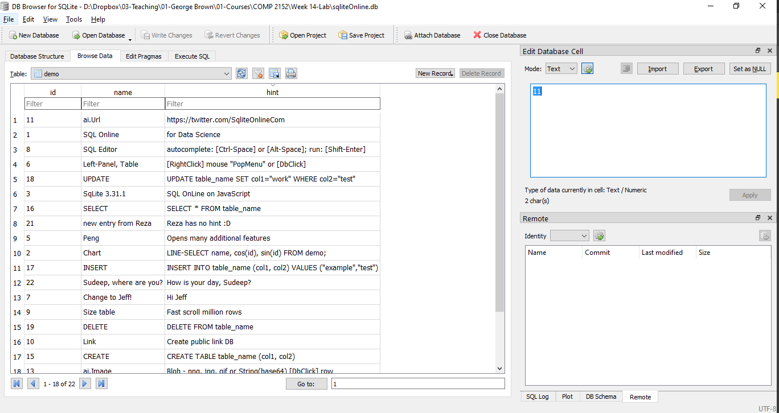
Creating a Python file and starting our journey
The result….

Slide 36
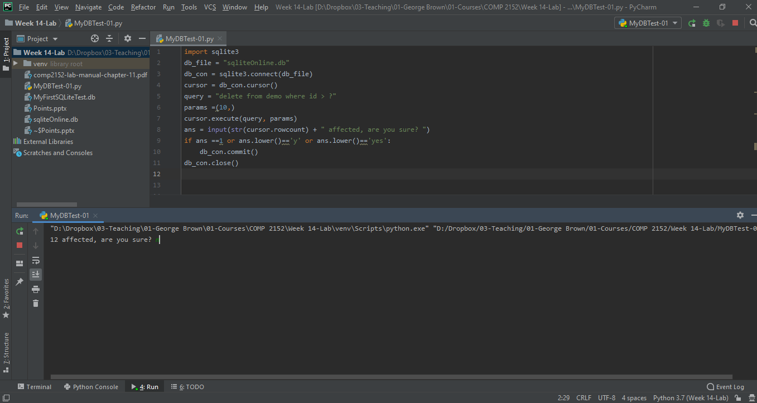
Creating a Python file and starting our journey
Deleting…. With the rowcount
Notes:
import sqlite3 db_file = "sqliteOnline.db" db_con = sqlite3.connect(db_file) cursor = db_con.cursor() query = "delete from demo where id > ?" params =(10,) cursor.execute(query, params) ans = input(str(cursor.rowcount) + " affected, are you sure? ") if ans ==1 or ans.lower()=='y' or ans.lower()=='yes': db_con.commit() db_con.close()

Slide 37

Creating a Python file and starting our journey
Normal coding that we tried before….
Notes:
import sqlite3 db_file = "sqliteOnline.db" db_con = sqlite3.connect(db_file) cursor = db_con.cursor() query = "select * from demo" cursor.execute(query) data = cursor.fetchall() print(data) db_con.close()

Slide 38
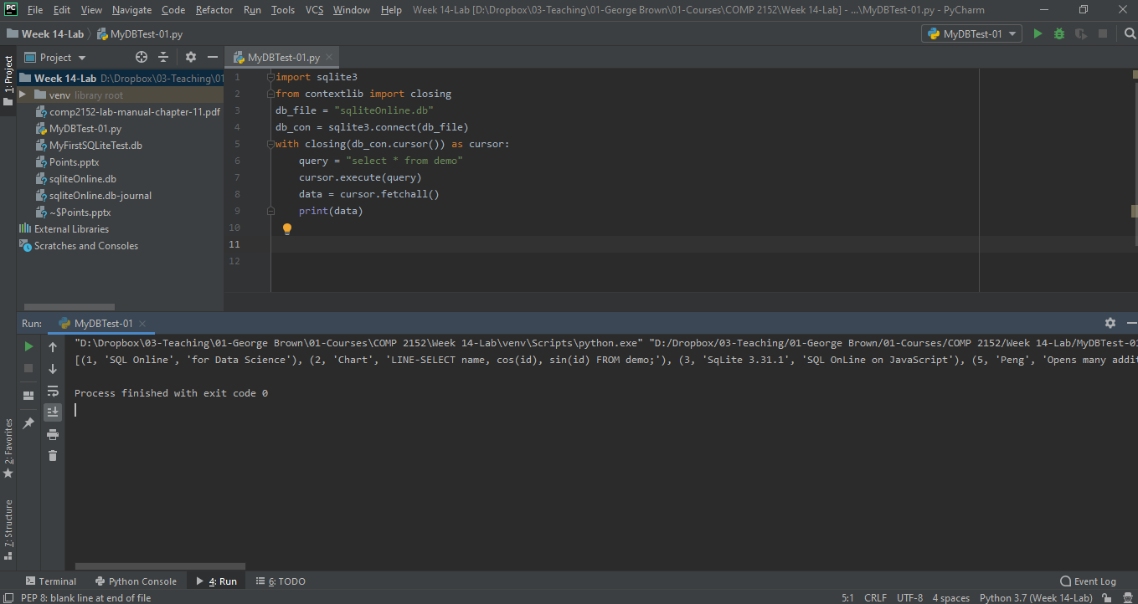
Creating a Python file and starting our journey
With closing statement….
Notes:
import sqlite3 from contextlib import closing db_file = "sqliteOnline.db" db_con = sqlite3.connect(db_file) with closing(db_con.cursor()) as cursor: query = "select * from demo" cursor.execute(query) data = cursor.fetchall() print(data)

Slide 39
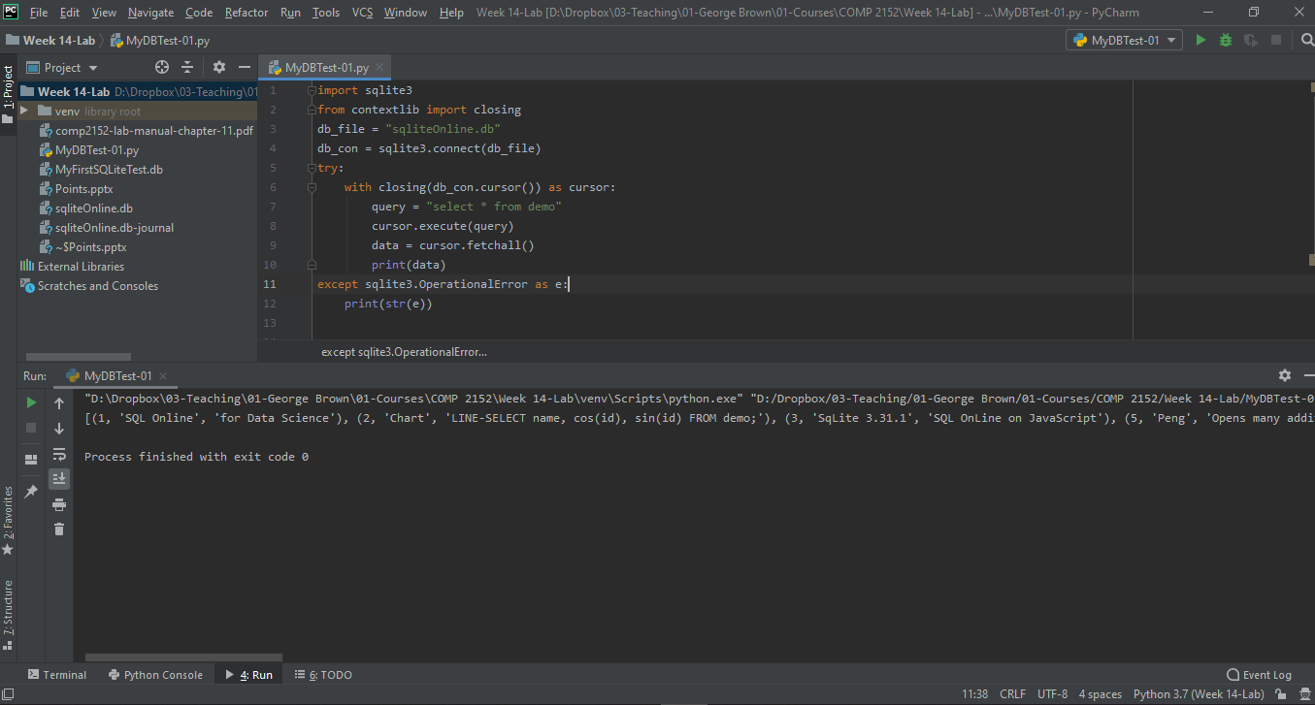
Creating a Python file and starting our journey
ERROR HANDLING….
Notes:
import sqlite3 from contextlib import closing db_file = "sqliteOnline.db" db_con = sqlite3.connect(db_file) try: with closing(db_con.cursor()) as cursor: query = "select * from demo" cursor.execute(query) data = cursor.fetchall() print(data) except sqlite3.OperationalError as e: print(str(e))

Slide 40

Thank you
Question?
To be
Not to be

